Slide 1
SMT resistor
Reed
Switch
Solder
Pad
PCB
Routed
slot

Slide 2
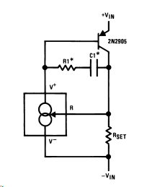



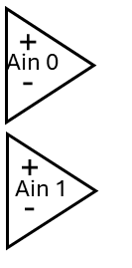

24Vdc
SMPS
24Vdc
Instrument
Power
Interface PCB
Custom Unit
Connector
Left
Right
Motor
Controller
Pololu
18V7
14ma
I-source
x8
Pump
4A DC Motor
Buffer/
Scaler
x8
+5Vdc
USB Hub
Laser
Keyance
LG-K
DUT
Sensor
x4
LV Win11
Workstation
DataQ
DI-2108

Slide 3
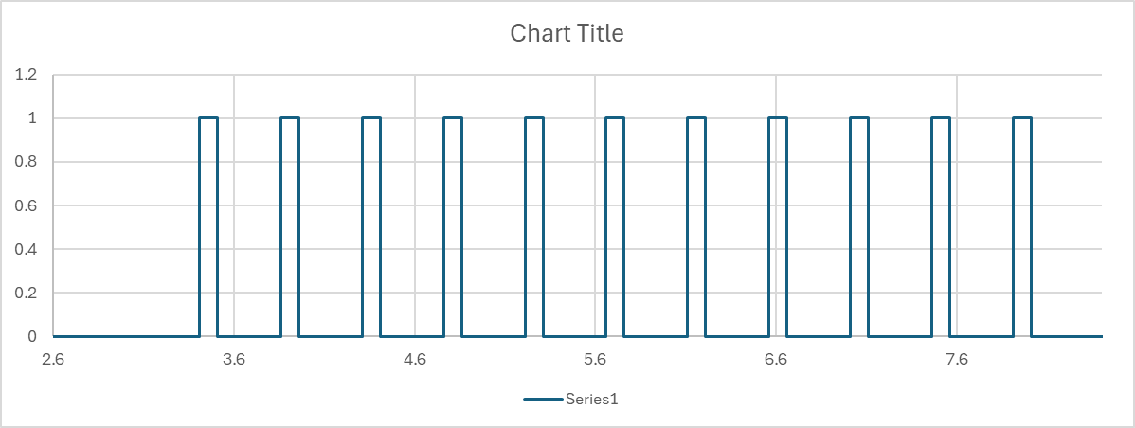

Slide 4
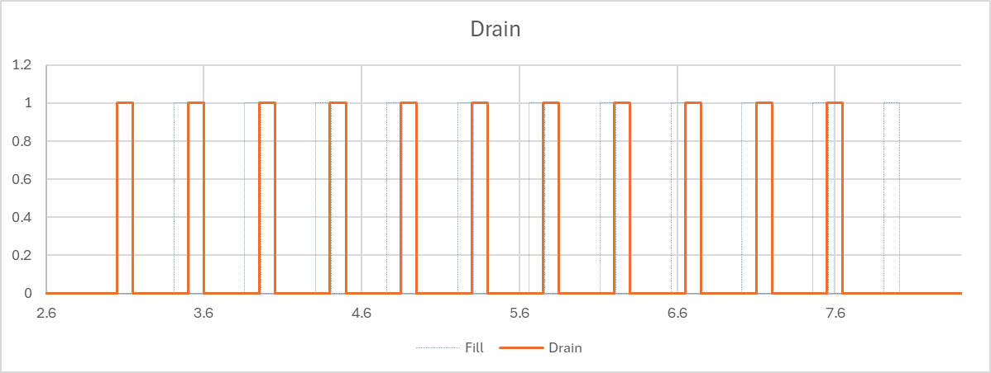
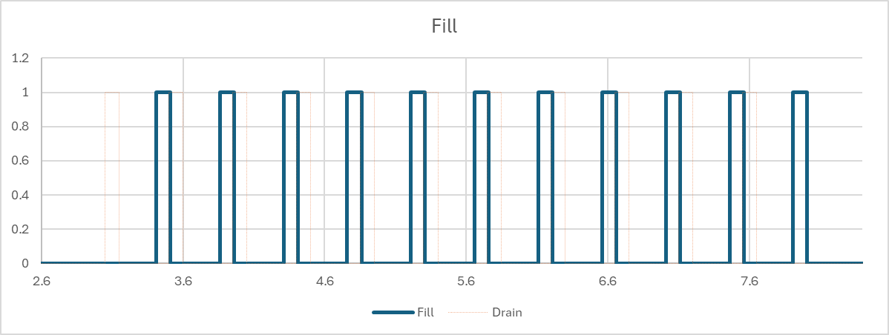
100
200
300
400
500
600
700
800
900
1000
1100
1100
DRAIN
Full | 10 | 9 | 8 | 7 | 6 | 5 | 4 | 3 | 2 | 1 | 0 | Empty
100
100
200
300
400
500
600
700
800
900
1000
1100
TEST RULES
Resistor must be in spec in “Measure R Zone.
Resistor value logged at mid point of Measure R Zone.
Log level when Resistor +/- 50Ω, must be n Switch Zone.
Indexed spec applied is based on measure Level.
TEST PROCEDURE
Select Test
Enter DUT ID.
Start Automatic Test
Go to FULL
Go to EMPTY
Got to FULL, make Fill Measurements
Go to EMPTY, make Drain Measurements
When EMPTY, test complete, print report.
FILL
Measure R Zone
Switch Zone
Full | 10 | 9 | 8 | 7 | 6 | 5 | 4 | 3 | 2 | 1 | 0 | Empty
Switch Threshold
0 Fill Hi
Index Spec 0 Values
1 Fill Hi
0 Fill Lo

Slide 5
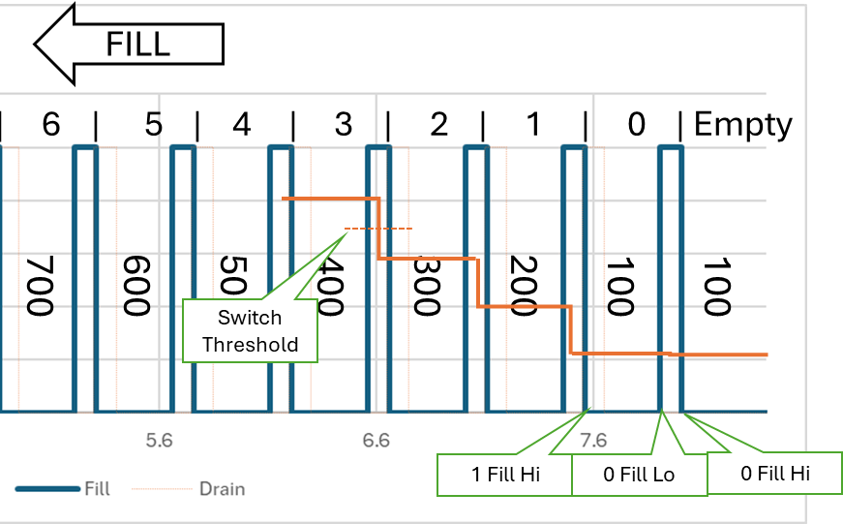
200Ω
Target TP Uncertainty
Target TP
(Test point)
Switch Point
100Ω
Switch Zone
Spec 1 Fill Hi
Spec 1 Fill Lo
Test Set Point
RNG_Stop

